Slide 1

Data Analytics Predicting electricity prices
Marcin Pilarski
Mateusz Saternus

Slide 2
Problem formulation
The energy market plays a crucial role in the economic development and sustainability of nations worldwide. The energy market in Poland faces multifaceted challenges, including fluctuating energy prices, increasing demand, changing regulatory frameworks, and the need to transition towards a more sustainable energy mix. These complexities pose significant difficulties for market participants, policymakers, and investors in making informed decisions regarding energy production, distribution, and consumption. To tackle these challenges effectively, it is crucial to understand the underlying patterns and interdependencies within the market, which can be achieved through statistical modelling.

Slide 3
Problem formulation – potencial use cases
The statistical modelling of the energy market in Poland offers a wide range of potential use cases across different sectors. For energy companies, the model can assist in optimizing production levels, pricing strategies, and investment decisions by providing insights into demand patterns and market conditions. Regulators and policymakers can leverage the model to evaluate the effectiveness of existing policies, design new regulations, and identify areas for promoting renewable energy sources and energy efficiency. Investors can use the model to assess the financial viability and risks associated with energy projects, aiding in informed decision-making.

Slide 4
Problem formulation – data sources
Data used in model comes from official databases. First database used in project is PVgis, which is tool released by European Commission. (https://re.jrc.ec.europa.eu/pvg_tools/en/) It helps to plan investitions in solar and wind energy sources. The data contains irradiance, wind speed, temperature.
The information about energy market such as energy prices and system load come from polish energy system operator (PSE). (https://www.pse.pl/obszary-dzialalnosci/rynek-energii/ceny-i-ilosc-energii-na-rynku-bilansujacym; https://www.pse.pl/dane-systemowe/funkcjonowanie-kse/raporty-dobowe-z-pracy-kse/wielkosci-podstawowe)

Slide 5
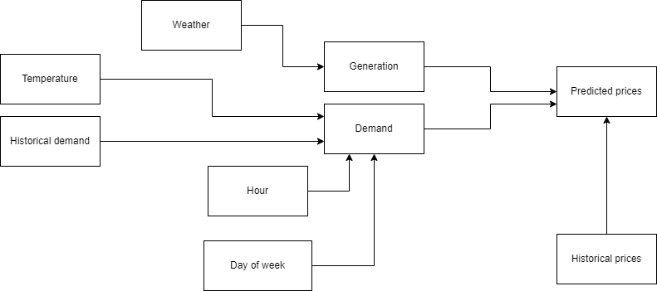
Problem formulation- Directed Acyclic Grap

Slide 6
Problem formulation - confoundings
There are few confoundings detected in the model.
The pipe type is on relation of weather->generation->price.
There are also fork type confoundings:
Hour -> Load <- Day of week
Generation -> Price <- Historical price

Slide 7
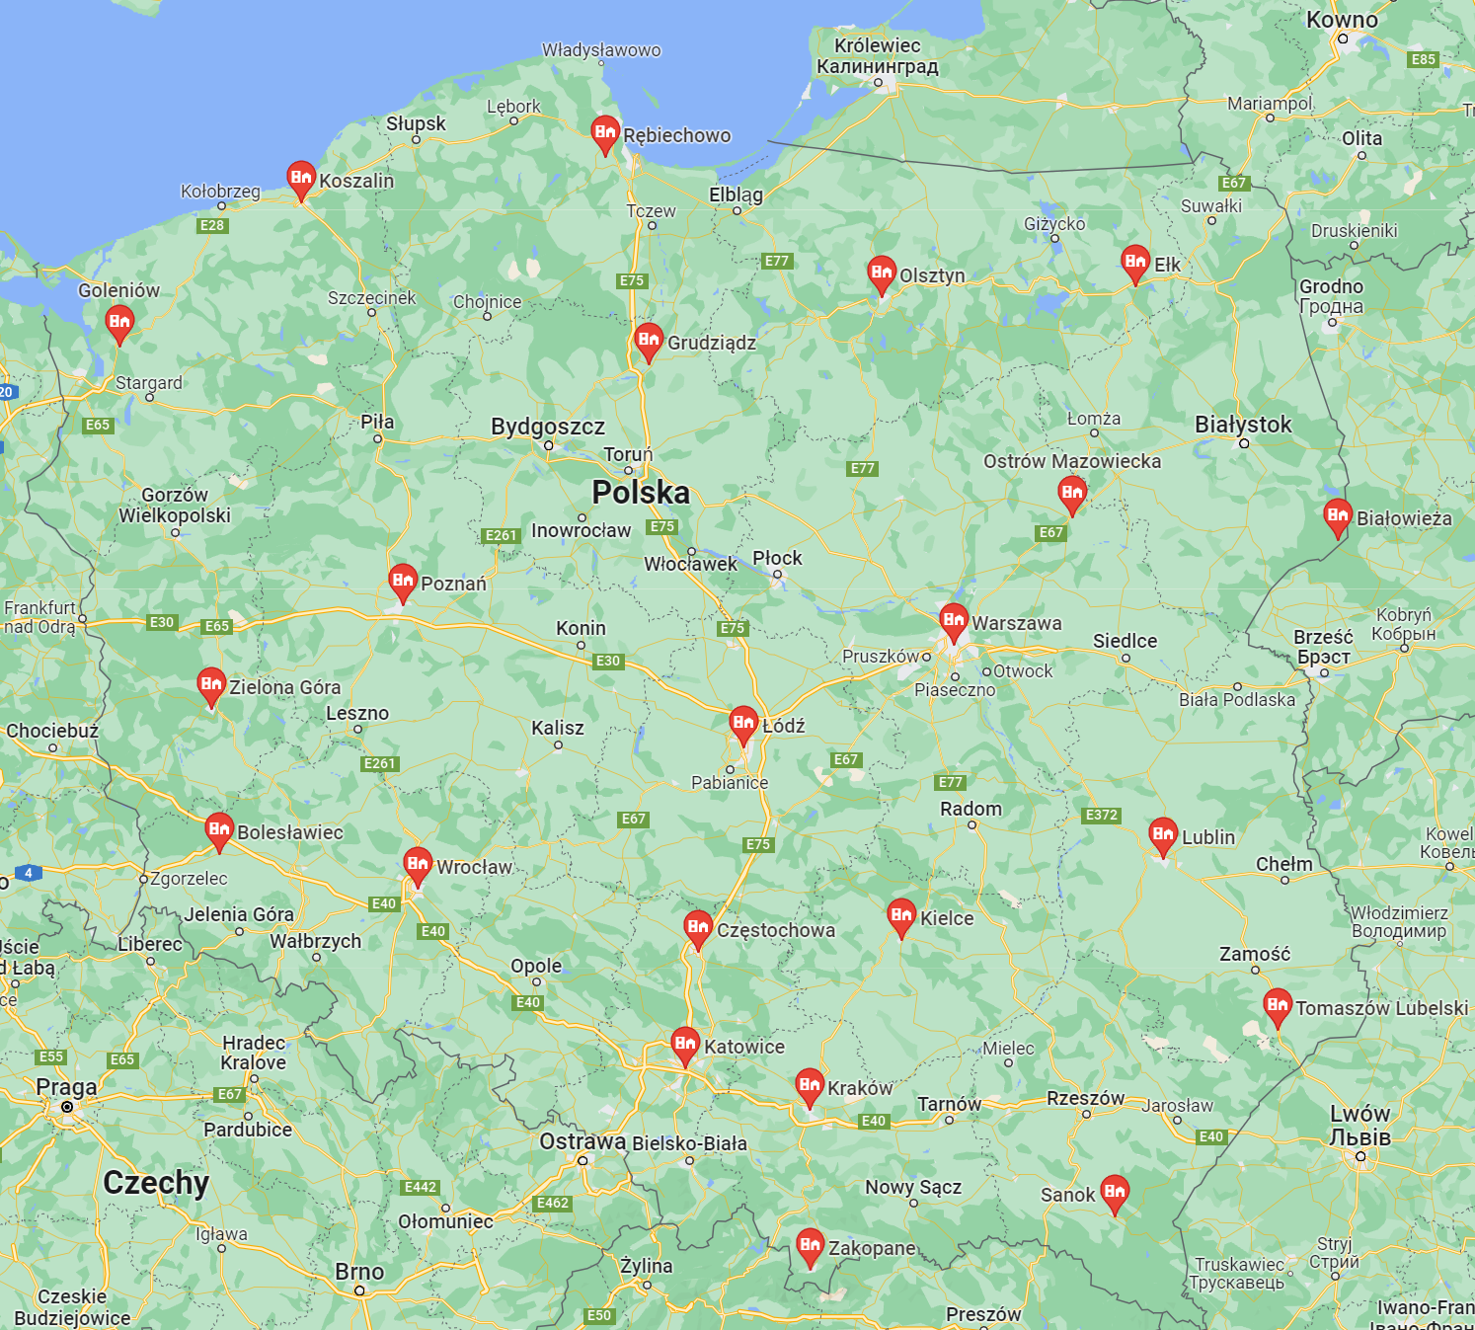
Data preprocessing
The data about the weather was downloaded from PVgis database. Although it contains all the weather values that were useful for us, it allows only to collect data locally and we need information for the whole country. Because of that we have chosen 22 points in Poland and calculated mean value at the time. Points are shown on the map. Data is collected every hour and was downloaded separately for year 2019 and 2020.
The data about the energy market was downloaded from PSE polish energy system operator. It was downloaded for march 2019 and march 2020 separately. It contained information about the system load and balancing market energy prices. The data was slightly changed to allow easier operations on dates.
Data from 2019 was used for prior and from 2020 for posterior

Slide 8
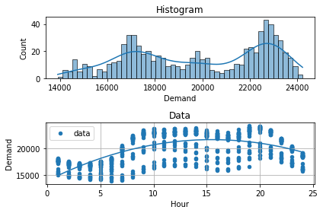
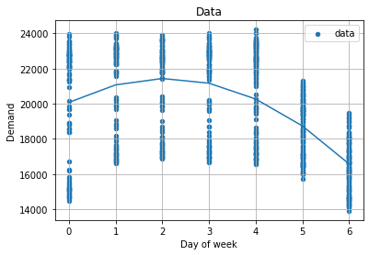
Model 1 – Demand
The load has been fitted with 2nd degree polynomial for each dependence on hour and day of week

Slide 9
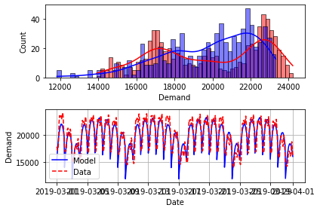
Model 1 – Demand - Prior
Fitting time data with 2nd degree polynomial allowed us to get samples with distribution shown below
Value of error was: RMSE = 1352.998 / (max possible) 19982.844

Slide 10
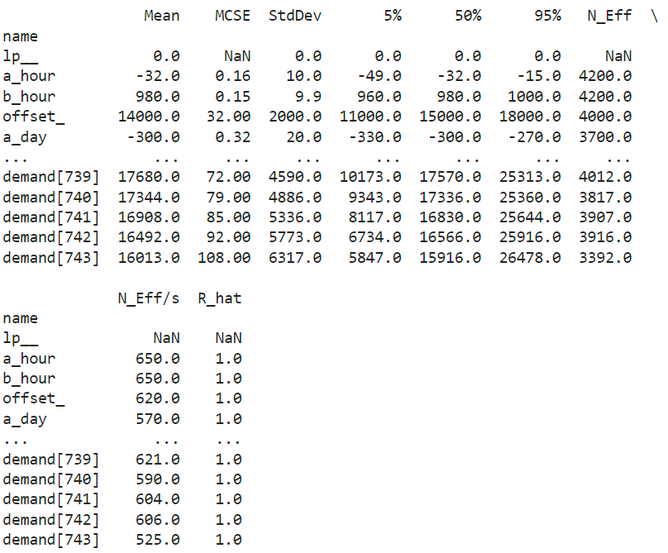
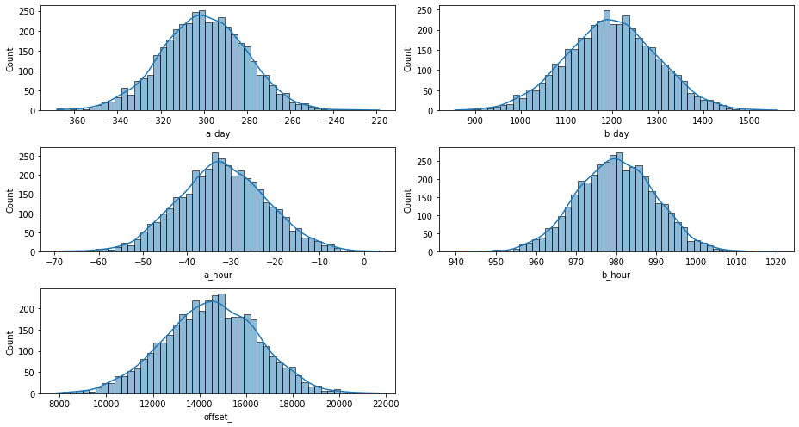
Model 1 – Demand – Prior Summary

Slide 11
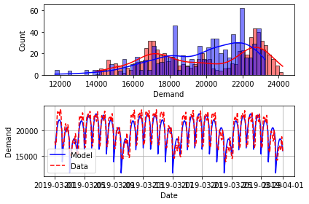
Model 1 – Demand – Posterior
Posterior modeling gave the results shown on graph
Value of error was: RMSE = 1348.9/ (max possible) 19982.8

Slide 12
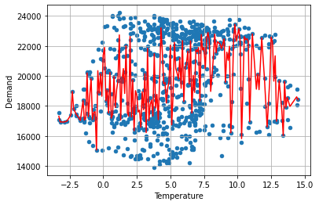
Temperature’s influence on the load
It seems that there is no influence of temperature on the demand, contrary to the project's assumptions.
Therefore, the influence of temperature was omitted in models

Slide 13
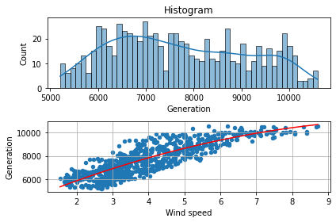
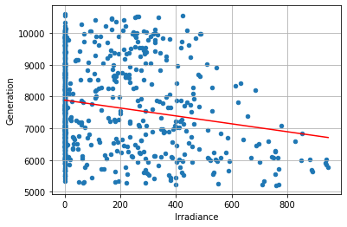
Model 1 - Generation
Generation dependence on wind and solar irradiance has been tested
As shown below, there is strong dependence on wind speed and almost no dependance on irradiation
Wind speed has been fitted with quadratic function and irradiance with linear
Therefore we omitted irradiation influence on generation in 1st model – it is added in the 2nd

Slide 14
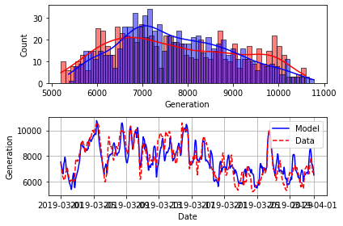
Model 1 – Generation - Prior
The prior distribution for Generation in 1st model is shown below
The value of error was: RMSE = 694.38 / (max possible) 7836.45

Slide 15
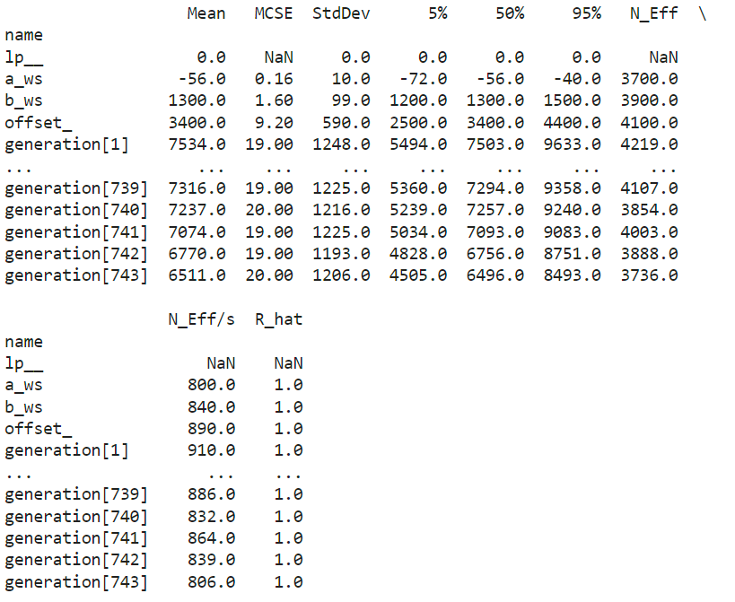
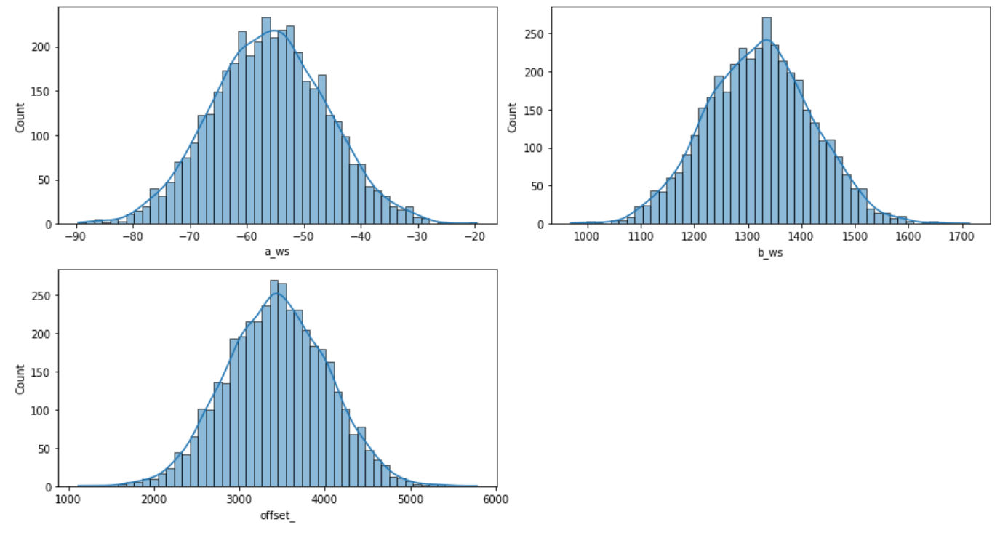
Model 1 – Generation – Prior summary

Slide 16
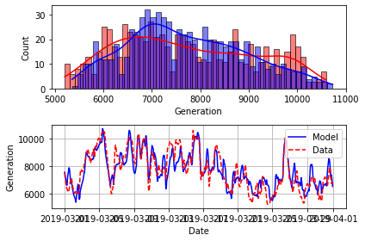
Model 1 – Posterior
Posterior modeling gave the results shown on graph
The error value was: RMSE = 694.48 / (max possible) 7836.45

Slide 17
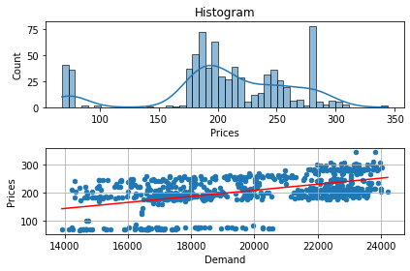
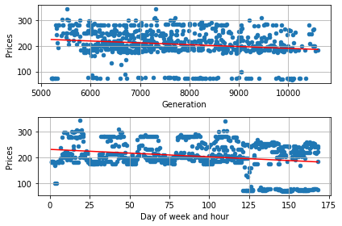
Model 1 - Prices
We have tried to determine the relations with load, generation and day of week with linear functions

Slide 18
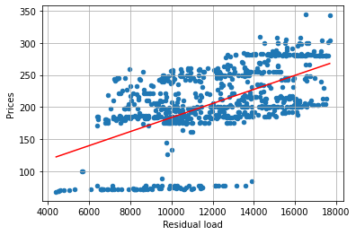
Model 1 - Prices
Finally we have decided to use the prices dependence on residulal load
Residual load is system load substracted by noncontrollable generation (called simply „Generation” in our project)

Slide 19
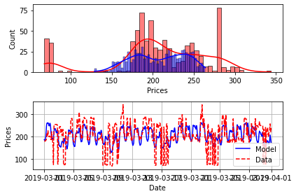
Model 1 – Prices - Prior
Modelling Prior for prices in 1st Model gave results shown below
The error value was: RMSE = 48.18 / (max possible) 214.47

Slide 20
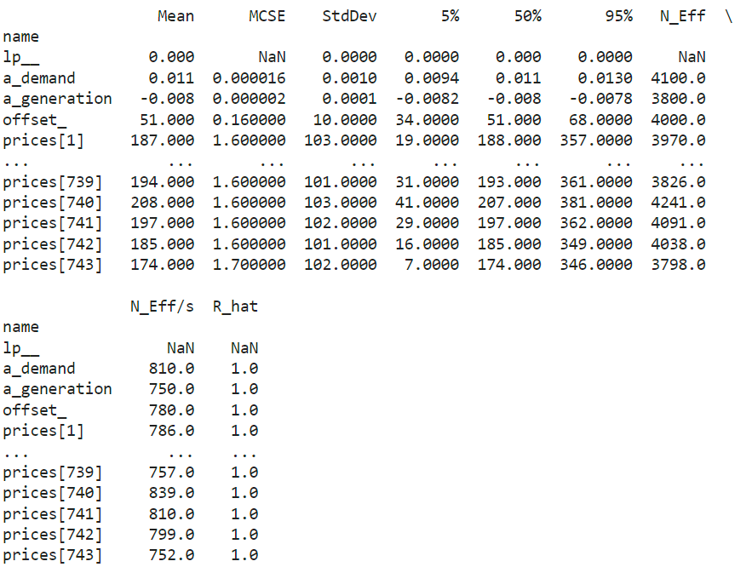
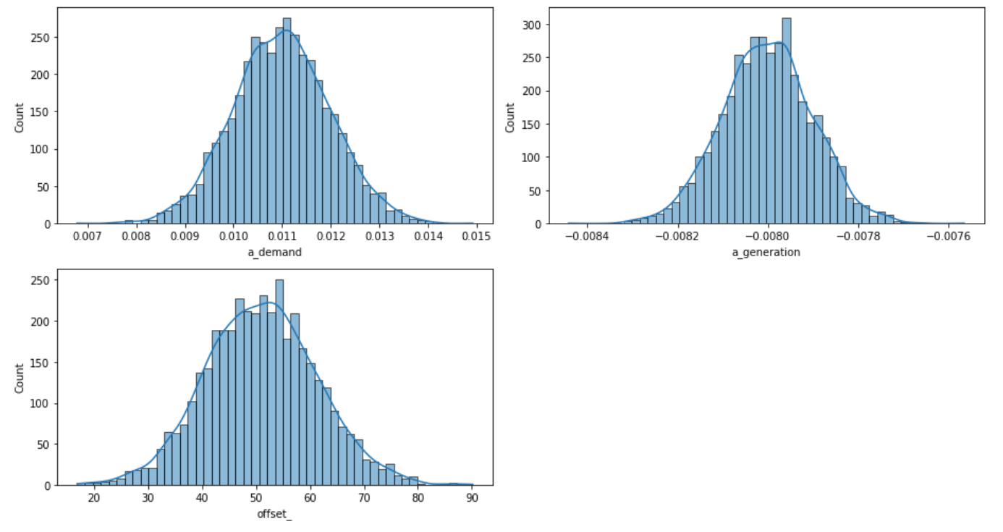
Model 1 – Prices – Prior summary

Slide 21
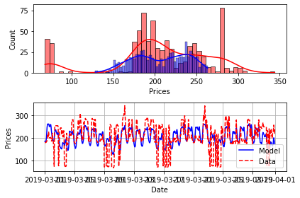
Model 1 – Prices - Posterior
Posterior model gave us results shown below
The error was: RMSE = 48.14 / (max possible) 214.47

Slide 22
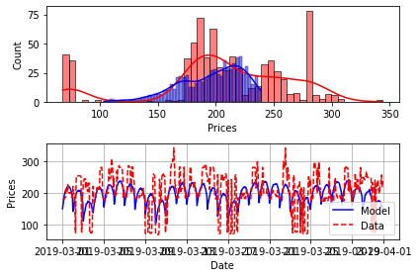
Model 1 – Overall posterior
Overall posterior results are shown below
The error value was: RMSE = 53.27 / (max possible) 214.47

Slide 24
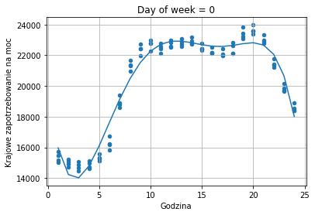
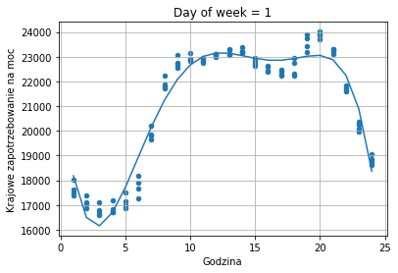
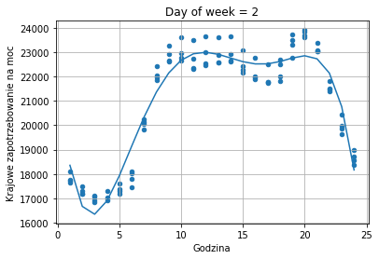

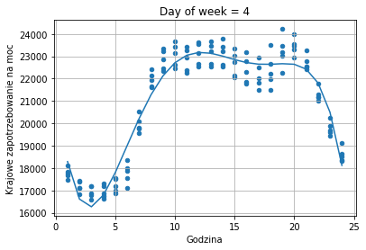
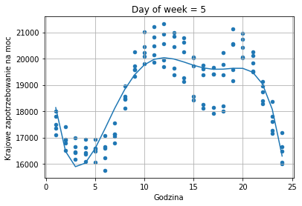
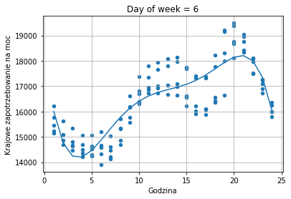
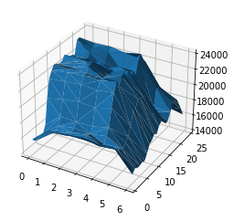
Demand dependance on day of week and hour – additional model
Hourly demand distriution has been done separately for each weekday

